Slide 1
Machine Learning Training with SPD Bank

Slide 2
Course Outline
Five-day training tailored for SPD Bank to prepare the team for an internal competition

Slide 3
Course Outline
Five-day training tailored for SPD Bank to prepare the team for an internal competition
Data Science Workflow, Data Cleaning and EDA
Course Introduction and Admin
Python and Pandas Revisited
Day 1

Slide 4
Course Outline
Five-day training tailored for SPD Bank to prepare the team for an internal competition
Day 2
Data Science Workflow, Data Cleaning and EDA
EDA with Seaborn and Matplotlib
Decision Trees
Course Introduction and Admin
Python and Pandas Revisited
Machine Learning Overview
Day 1

Slide 5
Course Outline
Five-day training tailored for SPD Bank to prepare the team for an internal competition
Day 2
Data Science Workflow, Data Cleaning and EDA
EDA with Seaborn and Matplotlib
Decision Trees
K-Means
Course Introduction and Admin
Python and Pandas Revisited
Machine Learning Overview
Random Forest, Extra Trees, Gradient Boosting
Day 1
Day 3

Slide 6
Course Outline
Five-day training tailored for SPD Bank to prepare the team for an internal competition
Day 2
Day 4
Data Science Workflow, Data Cleaning and EDA
EDA with Seaborn and Matplotlib
Decision Trees
K-Means
Feature Selection
Course Introduction and Admin
Python and Pandas Revisited
Machine Learning Overview
Random Forest, Extra Trees, Gradient Boosting
Feature Engineering
Day 1
Day 3

Slide 7
Course Outline
Five-day training tailored for SPD Bank to prepare the team for an internal competition
Day 2
Day 4
Data Science Workflow, Data Cleaning and EDA
EDA with Seaborn and Matplotlib
Decision Trees
K-Means
Feature Selection
QnA
Course Introduction and Admin
Python and Pandas Revisited
Machine Learning Overview
Random Forest, Extra Trees, Gradient Boosting
Feature Engineering
Recommender Systems
Day 1
Day 5
Day 3

Slide 8
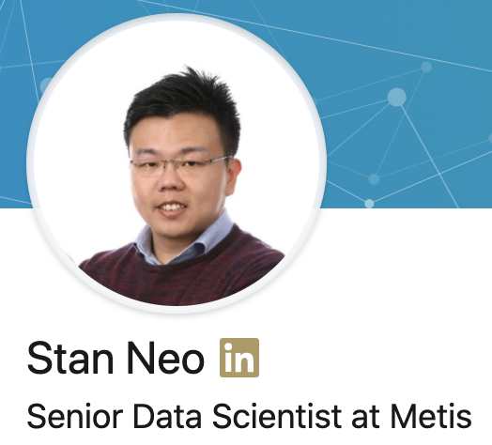


Trainer Profile
Stan Neo Han Wei
6 years of data science experience in Telecom, Banking, Consulting and Education industry.
He was the lead data scientist who developed DBS Bank’s first deep learning recommender system used for their mobile and internet banking advertisements.
He also spent 3 months in Shanghai to help DBS China develop machine learning models.
Lead Instructor and Senior Data Scientist for Metis SG which is a 12-weeks full-time immersive bootcamp
Taught more than 60 aspiring data scientists in Singapore and San Francisco under Metis.
His students have graduated and joined companies such as Apple, Facebook, Dell, DBS Bank, Scribd, Instacart, NCS, Axiata, Shopee, etc.
In total, he has conducted about 2,400 hours of analytics-related training (in Singapore and San Francisco)
https://www.linkedin.com/in/nhanwei/

